Slide 1
Decomposition algorithms in normalization, files and storage structures: files

Slide 2



AIM OF THE SESSION
To familiarize students with the basic concept i.e., to break down complex ideas or concepts into simpler, more manageable parts or components.
INSTRUCTIONAL OBJECTIVES
This Session is designed to facilitate understanding and analysis of complex ideas or concepts by breaking them down into simpler components.
LEARNING OUTCOMES
At the end of this session we should be able improved understanding, problem-solving, communication, critical thinking, decision-making, creativity, organizational skills, and domain knowledge.

Slide 3
DECOMPOSITION
Decomposition in DBMS removes redundancy, anomalies and inconsistencies from a database by dividing the table into multiple tables.
In the context of database design, a session description that involves decomposition typically refers to the process of breaking down a large table into smaller tables to improve the overall efficiency and functionality of a database.
This process of breaking of large table into smaller tables involves identifying groups of related attributes within the larger table and separating them into smaller tables that are more focused on specific aspects of the data.

Slide 4
DECOMPOSITION (Cont..)
The session description may also detail the rules and guidelines for decomposition, including best practices for naming the smaller tables and columns, establishing relationships between tables, and ensuring that data is not lost during the process.
In addition to outlining the decomposition process, the session description may also include examples of how decomposition can improve database performance and efficiency.
For example
By breaking down a large, complex table into smaller, more focused tables, queries can be executed more quickly, and data redundancy can be reduced, leading to a more streamlined and efficient database overall.

Slide 5
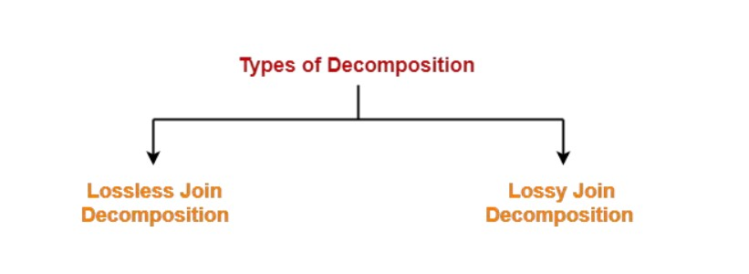
DECOMPOSITION (Cont..)
Decomposition is categorized as follows

Slide 6
DECOMPOSITION (Cont..)
Lossless Decomposition:
Lossless decomposition is a process in database normalization where a relation (table) is decomposed into multiple smaller relations (tables) in such a way that the original information can be reconstructed by joining the smaller tables together without any loss of data. In other words, the decomposition process preserves all the functional dependencies that existed in the original relation.

Slide 7
For Example consider Table 1 and Table 2 with following set of attributes
Table 1 <EmpDetails>
Emp_ID | Emp_Name | Emp_Age | Emp_Location
E001 | Jacoob | 29 | Albama
E002 | Henry | 32 | Albama
E003 | Tom | 22 | Texas
Table 2 <DeptDetails>
Dept_ID | Emp_ID | Dept_Name
Dpt1 | E001 | Operations
Dpt2 | E002 | HR
Dpt3 | E003 | Finance
Now, Natural Join is applied on the above two tables:

Slide 8
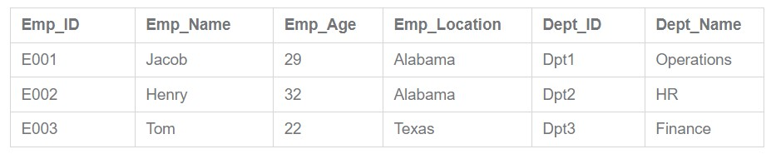
The result will be as follows −
Therefore, the above relation had lossless decomposition i.e. no loss of information.

Slide 9
Lossy Decomposition
Careless decomposition is another name for lossy join decomposition. It is because there is an introduction of various extraneous tuples in the sub relations’ natural join. These extraneous tuples make it very difficult to identify the original tuples.
Example
Consider the table i.e., <Cand_Info>
Cand_ID | Cand_Name | Cand_Age | Cand_Location | Sec_ID | Sec_Name
HX001 | Kevin | 45 | New York | Sec 1 | Operations
HX001 | Raymond | 49 | Los Angeles | Sec 2 | HR
HX001 | Marco | 39 | San Diego | Sec 3 | Finance

Slide 10
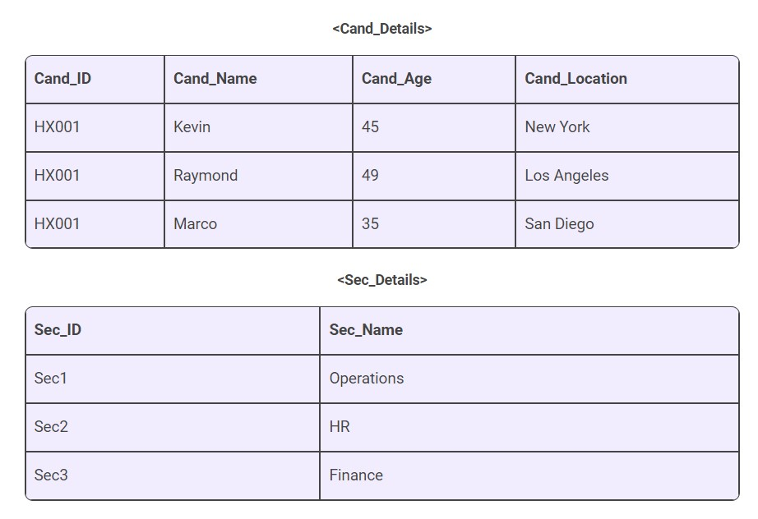
Let us now decompose this table into two tables like this:
Now, if we try to join both the tables mentioned above, we won’t be able to do it- since the relation Cand_ID isn’t part of the relation Sec_Details. Thus, this relation mentioned here is a lossy decomposition.

Slide 11
ACTIVITIES/ CASE STUDIES/ IMPORTANT FACTS RELATED TO THE SESSION
Activity 1
Library Management System
Provide students with a case study about a library management system that includes information about books, borrowers, loans, and reservations. Ask them to design a database that reflects the functional dependencies between these entities. Then, have them decompose the database into smaller tables that reflect the different aspects of library management, such as book titles, author information, borrower profiles, loan histories, and reservation lists.
Activity 2
Student Information System
Ask students to design a database for a student information system that includes information about students, courses, and grades. Then, have them decompose the database into smaller, more manageable tables based on functional dependencies.

Slide 12
EXAMPLES
LinkedIn:
LinkedIn is a social networking platform that allows individuals to create professional profiles, connect with others in their industry, and search for job opportunities. The company's database includes information about users, companies, job postings, and messaging. To ensure that the database is organized and scalable, LinkedIn has implemented a decomposed data model that includes separate tables for user profiles, company pages, job postings, and messages. This allows LinkedIn to easily manage millions of users and provide accurate information to recruiters and job seekers.

Slide 13
SUMMARY
In conclusion, decomposition is an essential concept in database management systems (DBMS) that involves breaking down a larger table into smaller, more focused tables. This allows for the reduction of data redundancy, improvement of data integrity, and scalability of the database. There are several types of decompositions, including 1NF, 2NF, 3NF, BCNF, and 4NF, each addressing a specific issue or normalization requirement. Decomposition is widely used by various organizations to improve their data management, including Airbnb, LinkedIn, Uber, and Amazon, which have implemented decomposed data models to manage their large volumes of data efficiently and effectively. By applying decomposition in DBMS, organizations can ensure that their data is organized, accurate, and accessible, enabling them to make informed decisions based on reliable information.

Slide 14
SELF-ASSESSMENT QUESTIONS
Which of the following is a drawback of decomposition?
It can lead to an increase in data redundancy.
It can lead to an decrease in data integrity.
It can make database less scalable
It can make database more difficult to maintain
Which of the following is not a reason for using decomposition in DBMS?
(a) To reduce data redundancy.
To improve data integrity.
To increase data redundancy.
To ensure scalability of the database.

Slide 15
SELF-ASSESSMENT QUESTIONS
3. What is decomposition in database management systems?
It is a process of combining multiple tables into one table.
It is a process of breaking down a larger table into smaller, more focused tables.
It is a process of encrypting data to protect it from unauthorized access.
It is a process of adding data to a table.
4. Which of the following is an advantage of decomposition in DBMS?
It can increase data redundancy
It can decrease data integrity
It can improve query performance
It can make the database more difficult to maintain

Slide 16
TERMINAL QUESTIONS
1. Describe the concept of decomposition in brief
2. List out the difference among lossless decomposition and lossy decomposition
3. Analyze decomposition concept with any case study and justify which is better (case studies like students information system, Library Management System )
4. Summarize brief about decomposition concept

Slide 17
REFERENCES FOR FURTHER LEARNING OF THE SESSION
Reference Books:
1. "Database Management Systems" by Raghu Ramakrishnan and Johannes Gehrke - This is a comprehensive textbook that covers both theoretical and practical aspects of DBMS, including data modeling, relational algebra, SQL, query optimization, transaction management, and distributed databases.
2. "Fundamentals of Database Systems" by Ramez Elmasri and Shamkant Navathe - This is another popular textbook that covers the fundamental concepts of DBMS, including database design, normalization, SQL programming, transaction management, and concurrency control.
Sites and Web links:
1. https://www.tutorialspoint.com/Lossless-and-Lossy-Decomposition-in-DBMS
2. https://www.javatpoint.com/decomposition-algorithms

Slide 18

THANK YOU
Team – Course Name

Slide 19

Department of CSE
COURSE NAME: DBMS
COURSE CODE:22CS2110 RA
Topic: Files and Storage Structures : Files
Session - 1

Slide 20
AIM OF THE SESSION
To familiarize students with the basic concept of Files and type of files
INSTRUCTIONAL OBJECTIVES
This Session is designed to efficiently store and manage data in a structured and organized manner
LEARNING OUTCOMES
At the end of this session, you should be able to:
understanding different file organization techniques, storage structures, and normalization/denormalization concepts for efficient and organized data storage and retrieval.

Slide 21
SESSION INTRODUCTION
Files are a fundamental component of DBMS, serving as a way to store and organize data in a structured manner for efficient retrieval and manipulation. We will discuss various storage structures used in DBMS, namely sequential, Heap, Hash, Clustered and indexed access methods, and how they impact the performance and efficiency of file operations in a database system. Understanding files and storage structures in DBMS is crucial for designing and implementing efficient and reliable database systems.

Slide 22
SESSION DESCRIPTION
A database consists of a huge amount of data. The data is grouped within a table in RDBMS, and each table has related records. A user can see that the data is stored in form of tables, but in actual this huge amount of data is stored in physical memory in form of files.
File – A file is named collection of related information that is recorded on secondary storage such as magnetic disks, magnetic tapes and optical disks.
What is File Organization?
File Organization refers to the logical relationships among various records that constitute the file, particularly with respect to the means of identification and access to any specific record. In simple terms, Storing and organizing the files in certain order is called file Organization. File Structure refers to the format of the label and data blocks and of any logical control record.

Slide 23
SESSION DESCRIPTION (Cont..)
Types of File Organizations –
Various methods have been introduced to Organize files. These particular methods have advantages and disadvantages on the basis of access or selection . Thus it is all upon the programmer to decide the best suited file Organization method according to his requirements.
Some types of File Organizations are :
Sequential File Organization
Heap File Organization
Hash File Organization
B+ Tree File Organization
Clustered File Organization
We will be discussing each of the file Organizations in further sets of this article along with differences and advantages/ disadvantages of each file Organization methods.

Slide 24
SESSION DESCRIPTION (Cont..)
1.Sequential File Organization –
The easiest method for file Organization is Sequential method. In this method the file are stored one after another in a sequential manner. There are two ways to implement this method:
      Pile File Method and
      Sorted File Method

Slide 25
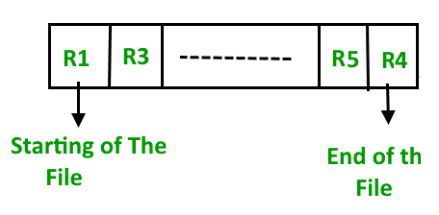
SESSION DESCRIPTION (Cont..)
Pile File Method
This method is quite simple, in which we store the records in a sequence i.e one after other in the order in which they are inserted into the tables.

Slide 26
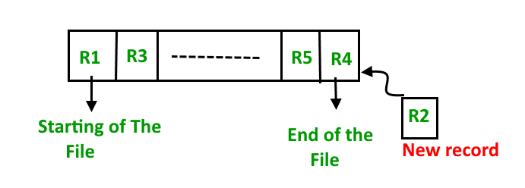
Insertion of new record –
Let the R1, R3 and so on upto R5 and R4 be four records in the sequence. Here, records are nothing but a row in any table. Suppose a new record R2 has to be inserted in the sequence, then it is simply placed at the end of the file.
In sequential method there is no option for deleting the record

Slide 27
Merits and Demerits of Pile file method
Merits
The only advantage of this method is simplicity
Demerits
Difficulty in accessing data
Data redundancy
Limited data processing capabilities
Security issues

Slide 28
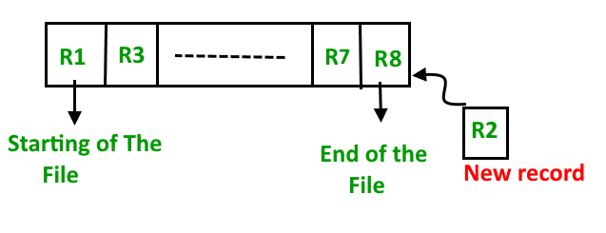
Sorted File Method –
In this method, As the name itself suggest whenever a new record has to be inserted, it is always inserted in a sorted (ascending or descending) manner. Sorting of records may be based on any primary key or any other key.

Slide 29
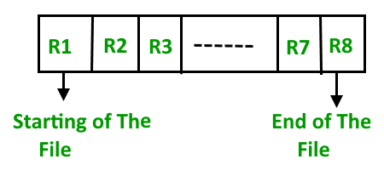
Insertion of new record –
Let us assume that there is a preexisting sorted sequence of four records R1, R3, and so on upto R7 and R8. Suppose a new record R2 has to be inserted in the sequence, then it will be inserted at the end of the file and then it will sort the sequence.

Slide 30
Pros
Easy to Search: Because the data is sorted in a specific order, it is much easier to search for specific records or subsets of records based on a given criteria. This can lead to faster processing times when querying or accessing the data.
Efficient for Large Datasets: When working with large datasets, the sorted file method can be an efficient way to manage and store the data. It can help minimize the amount of time and resources needed to perform complex queries or calculations.
Can be Used for Range Queries: Since the data is sorted, range queries such as finding all records within a specific date range or within a certain value range can be easily performed.
Facilitates Merge Operations: The sorted file method makes it easy to merge two sorted files into a single, sorted file, which can be useful when working with large datasets or when updating existing data.

Slide 31
Cons:
Slow Inserts: One major disadvantage of the sorted file method is that inserting new records can be slow and inefficient. Every time a new record is inserted, the entire file must be re-sorted, which can be time-consuming and resource-intensive.
Data Must be Pre-Sorted: In order to use the sorted file method, the data must be pre-sorted based on the field or fields being used. This can add extra steps to the data preparation process and can be a significant drawback if the data is constantly changing or being updated.
Limited Sorting Criteria: Sorting can only be done based on one or a few fields. This can limit the flexibility of the method, and it may not be suitable for all types of data or queries.
Wasted Space: In some cases, the sorted file method can result in wasted space, especially if there are large gaps between records or if the records vary widely in size. This can lead to inefficient use of storage resources.

Slide 32
Pros and Cons of Sequential File Organization –
Pros –
Fast and efficient method for huge amount of data.
Simple design.
Files can be easily stored in magnetic tapes i.e cheaper storage mechanism.
Cons –
Time wastage as we cannot jump on a particular record that is required, but we have to move in a sequential manner which takes our time.
Sorted file method is inefficient as it takes time and space for sorting records.

Slide 33
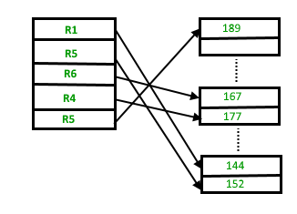
2.Heap File Organization
Heap File Organization works with data blocks. In this method records are inserted at the end of the file, into the data blocks. No Sorting or Ordering is required in this method. If a data block is full, the new record is stored in some other block, Here the other data block need not be the very next data block, but it can be any block in the memory. It is the responsibility of DBMS to store and manage the new records.

Slide 34
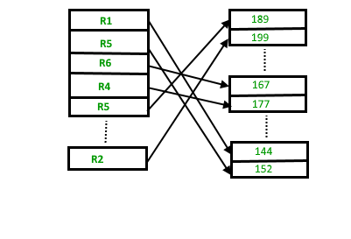
Insertion of new record –
Suppose we have four records in the heap R1, R5, R6, R4 and R3 and suppose a new record R2 has to be inserted in the heap then, since the last data block i.e data block 3 is full it will be inserted in any of the data blocks selected by the DBMS, lets say data block 1.
If we want to search, delete or update data in heap file Organization the we will traverse the data from the beginning of the file till we get the requested record.
Thus if the database is very huge, searching, deleting or updating the record will take a lot of time.

Slide 35
Pros and Cons of Heap File Organization –
Pros –
Fetching and retrieving records is faster than sequential record but only in case of small databases.
When there is a huge number of data needs to be loaded into the database at a time, then this method of file Organization is best suited.
Cons –
Problem of unused memory blocks.
Inefficient for larger databases.

Slide 36
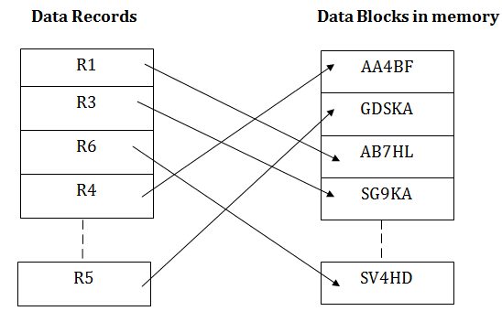
3. Hash File Organization:
Hash File Organization uses the computation of hash function on some fields of the records. The hash function's output determines the location of disk block where the records are to be placed.
When a record has to be received using the hash key columns, then the address is generated, and the whole record is retrieved using that address. In the same way, when a new record has to be inserted, then the address is generated using the hash key and record is directly inserted. The same process is applied in the case of delete and update.

Slide 37
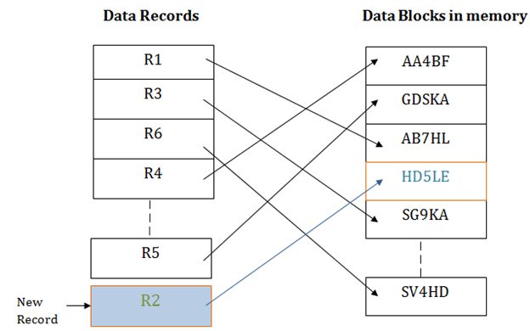
In this method, there is no effort for searching and sorting the entire file. In this method, each record will be stored randomly in the memory.

Slide 38
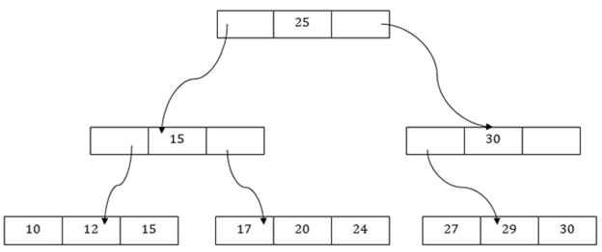
4. B+ File Organization
B+ tree file organization is the advanced method of an indexed sequential access method.
It uses a tree-like structure to store records in File.
It uses the same concept of key-index where the primary key is used to sort the records. For
each primary key, the value of the index is generated and mapped with the record.
The B+ tree is similar to a binary search tree (BST), but it can have more than two children. In
this method, all the records are stored only at the leaf node. Intermediate nodes act as a pointer to
the leaf nodes. They do not contain any records.

Slide 39
The above B+ tree shows that
There is one root node of the tree, i.e., 25.
There is an intermediary layer with nodes. They do not store the actual record. They have only
pointers to the leaf node.
The nodes to the left of the root node contain the prior value of the root and nodes to the right
contain next value of the root, i.e., 15 and 30 respectively.
There is only one leaf node which has only values, i.e., 10, 12, 17, 20, 24, 27 and 29.
Searching for any record is easier as all the leaf nodes are balanced.
In this method, searching any record can be traversed through the single path and accessed
easily.

Slide 40
Pros of B+ tree file organization
In this method, searching becomes very easy as all the records are stored only in the leaf nodes
and sorted the sequential linked list.
Traversing through the tree structure is easier and faster.
The size of the B+ tree has no restrictions, so the number of records can increase or decrease
and the B+ tree structure can also grow or shrink.
It is a balanced tree structure, and any insert/update/delete does not affect the performance of
tree.
Cons of B+ tree file organization
This method is inefficient for the static method.

Slide 41
5. Clustered File Organization
When the two or more records are stored in the same file, it is known as clusters. These files
will have two or more tables in the same data block, and key attributes which are used to map
these tables together are stored only once.
This method reduces the cost of searching for various records in different files.
The cluster file organization is used when there is a frequent need for joining the tables with
the same condition. These joins will give only a few records from both tables. In the given
example, we are retrieving the record for only particular departments. This method can't be used
to retrieve the record for the entire department.

Slide 42
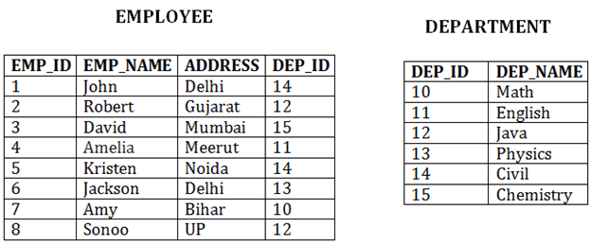

Slide 43
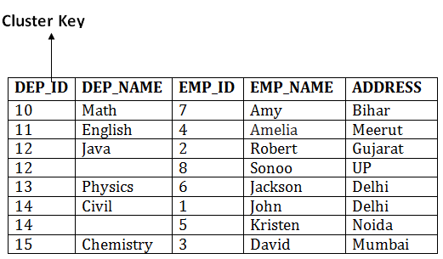
In this method, we can directly insert, update or delete any record. Data is sorted based on the key with which searching is done. Cluster key is a type of key with which joining of the table is performed.

Slide 44
ACTIVITIES/ CASE STUDIES/ IMPORTANT FACTS RELATED TO THE SESSION
Important Facts:
File organization in DBMS refers to how data is stored and accessed in files within a database system.
Different file organizations in DBMS have different performance characteristics, such as efficiency, scalability, and ease of data retrieval and modification.
File operations in DBMS, such as record insertion, deletion, and update, can affect the performance and integrity of the database system, and need to be carefully managed.
Techniques such as indexing, clustering, and partitioning can be used to optimize file performance in DBMS and improve the overall efficiency of database operations.

Slide 45
EXAMPLES
Data files
Index files
Transaction log files
Backup files
Metadata files
Parameter files
Script files
Error log files
Query log files
Temporary files

Slide 46
SUMMARY
In a database management system (DBMS), files are used to store data in a structured format that allows for efficient retrieval and manipulation. There are several types of files used in DBMS, including data files, index files, transaction log files, backup files, metadata files, parameter files, script files, error log files, query log files, and temporary files. Each type of file serves a specific purpose in managing and organizing data in a database. Understanding the role of each file type is crucial for effective database design and maintenance.

Slide 47
SELF-ASSESSMENT QUESTIONS
1. Which type of file records all the changes made to the database, including inserts, updates, and deletes?
Transaction log file
Backup Files
Metadata Files
Script Files
2. Which type of file contains information about the database structure and schema, such as table and column names, data types, constraints, and relationships?
Metadata Files
Data Files
Index Files
Parameter Files

Slide 48
TERMINAL QUESTIONS
1. Describe various file organization techniques used in DBMS?
2. List out the strengths and weaknesses of different file organization techniques
3. Analyze the performance of a particular file organization strategy for a given workload, and recommend optimizations.
4. Summarize about indexed file organization work, and what are its pros and cons?

Slide 49
REFERENCES FOR FURTHER LEARNING OF THE SESSION
Reference Books:
1. "Database Management Systems" by Raghu Ramakrishnan and Johannes Gehrke - This is a comprehensive textbook that covers both theoretical and practical aspects of DBMS, including data modeling, relational algebra, SQL, query optimization, transaction management, and distributed databases.
2. "Fundamentals of Database Systems" by Ramez Elmasri and Shamkant Navathe - This is another popular textbook that covers the fundamental concepts of DBMS, including database design, normalization, SQL programming, transaction management, and concurrency control.
Sites and Web links:
1. https://www.tutorialspoint.com/dbms/dbms_file_organization.htm
2. https://www.geeksforgeeks.org/introduction-to-file-structures-in-dbms/

Slide 50
THANK YOU
Team – Course Name

